Slide 1
Kaggle训练营

Slide 2
Data Analysis Project Procedure
Understand the Data
Data Cleaning
Missing Data
Outliers
Numerical vs. Categorical
Feature Engineering
Modeling
70% of the efforts, but crucial to the final success

Slide 3
Regression vs. Classification
Regression: estimating the relationships between a dependent variable (numerical/quantity) and independent variables
Classification: estimating the relationships between a dependent variable (label/categorical variables) and independent variables

Slide 4
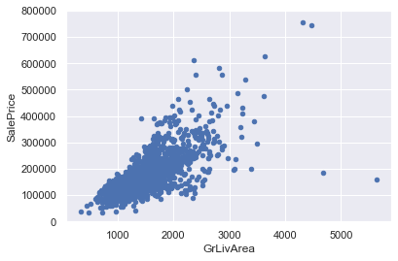
Why Data Cleaning is Important

